Slide 1
Digital Portfolio
STUDENT NAME: Harshini KP
REGISTER NO AND NMID: asbruaz2428c0474
DEPARTMENT: II - B.Sc.AIML
COLLEGE: KPR College Of Arts Science And Research / Bharathiar university

Slide 2
PROJECT TITLE
Research Scholar Portfolio using HTML,CSS and JAVASCRIPT.

Slide 3


AGENDA
Problem Statement
Project Overview
End Users
Tools and Technologies
Portfolio design and Layout
Features and Functionality
Results and Screenshots
Conclusion
Github Link
3/21/2024 Annual Review

Slide 4

PROBLEM STATEMENT
Despite the critical importance of systematically tracking academic growth, publications, research contributions, and professional development, many research scholars lack a centralized and standardized portfolio system. This results in fragmented documentation, reduced visibility of research output, and missed opportunities for collaboration and funding. Furthermore, traditional methods of maintaining academic records—such as spreadsheets or word-processed CVs—are often inefficient, non-interactive, and fail to capture the dynamic and evolving nature of a scholar’s work.
There is a pressing need for a comprehensive, digital, and customizable Research Scholar Portfolio that not only consolidates academic and research accomplishments but also supports real-time updates, peer review integration, and metrics visualization. Such a system would enhance a researcher's academic identity, improve discoverability, and streamline career advancement processes.

Slide 5

PROJECT OVERVIEW
The Research Scholar Portfolio is a digital platform designed to centralize and showcase the academic journey, research outputs, and professional accomplishments of individual scholars. The primary goal of this project is to develop an intuitive, user-friendly, and customizable portfolio system that allows research scholars to document, manage, and present their academic profile in a structured and dynamic way.
Frontend: React.js / Angular / HTML5 / CSS3
Backend: Node.js / Django / Spring Boot
Database: MongoDB / MySQL / PostgreSQL

Slide 6








WHO ARE THE END USERS?
This portfolio is useful for individuals and institutions to document, showcase, and recognize academic and research contributions. It helps bridge the gap between scholars and the academic/research community while supporting professional growth, collaboration, and visibility.
. Research Scholars & Ph.D. Candidates – To track and present research work, publications, projects, and academic milestones.
. Academic Institutions & Universities – For evaluating research progress, supporting supervision, and generating reports for accreditation and rankings.
. Funding Agencies & Grant Committees – To assess the quality and impact of a scholar's research before awarding grants or fellowships.
. Professors & Research Supervisors – To monitor student progress, provide feedback, and evaluate contributions.
. Collaborators & Research Groups – To identify potential partners for interdisciplinary research and collaborative opportunities.
. Conference Organizers & Journal Editors – To verify credentials and invite qualified reviewers,
speakers, or authors.
. Employers in Academia & Industry – To evaluate a scholar’s expertise, research background,
and suitability for roles in research and development.

Slide 7
TOOLS AND TECHNIQUES
HTML5 – Structure of the portfolio pages (sections for profile, publications, etc.).
CSS3 – Styling, layout, animations, responsiveness.
JavaScript (Vanilla JS) – Logic for interactivity (e.g., toggles, dynamic content, forms).

Slide 8
POTFOLIO DESIGN AND LAYOUT
Header:
Introduces your mission: Dedicated to Research, Innovation & Academic Excellence.
Gives visitors an immediate idea of your academic identity and area of expertise.
About:
Briefly explains your research background, academic interests, and goals.
Highlights key focus areas: thesis topic, research domains, technical skills, and academic affiliations.
Sets the context for the scholarly work and achievements showcased in the portfolio.
Experience / Sections:
Research Projects – Describes current and completed research initiatives, methodology, outcomes, and your role.
Publications & Presentations – Lists journal articles, conference papers, posters, and invited talks with citation details or DOI links.
Academic Background – Details your educational qualifications (Bachelors, Masters, Ph.D.),
institutions, and academic milestones.

Slide 9
FEATURES AND FUNCTIONALITY
Navigation Bar with Smooth Scrolling:
The fixed top navigation allows users to quickly move between key sections (Home, About, Publications, Projects, Contact).
Smooth scrolling is implemented using JavaScript, providing a seamless browsing experience without sudden
jumps.
Research Showcase Layout:
Research outputs (like papers, projects, and presentations) are presented in a card or tabbed layout, with each card representing an individual contribution.
Cards include titles, abstracts/summaries, publication links (DOIs), and dates to ensure clarity and credibility. The layout is structured to highlight research milestones in a visually appealing and organized manner.
Interactive Elements:
Hover effects on publication and project cards use subtle animations (e.g., scaling or shadowing) to create a dynamic user experience.
Interactive CV download, ORCID and Google Scholar buttons enhance user engagement.
Section transitions and animations guide the visitor's focus without overwhelming the interface.

Slide 10
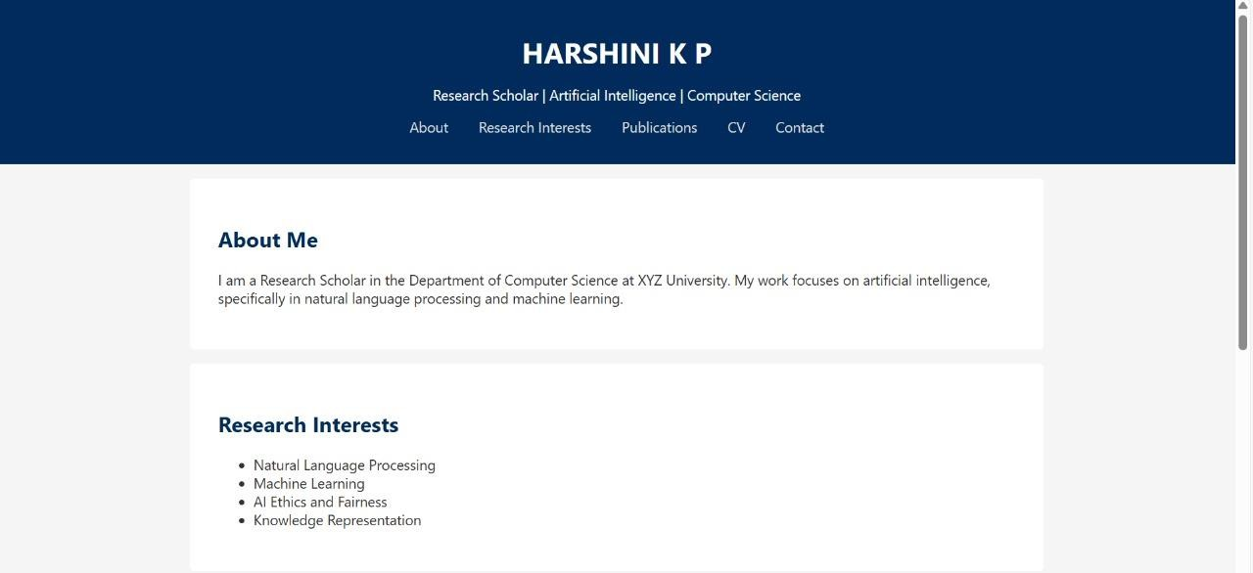
RESULTS AND SCREENSHOTS
3/21/2024 Annual Review
10

Slide 11
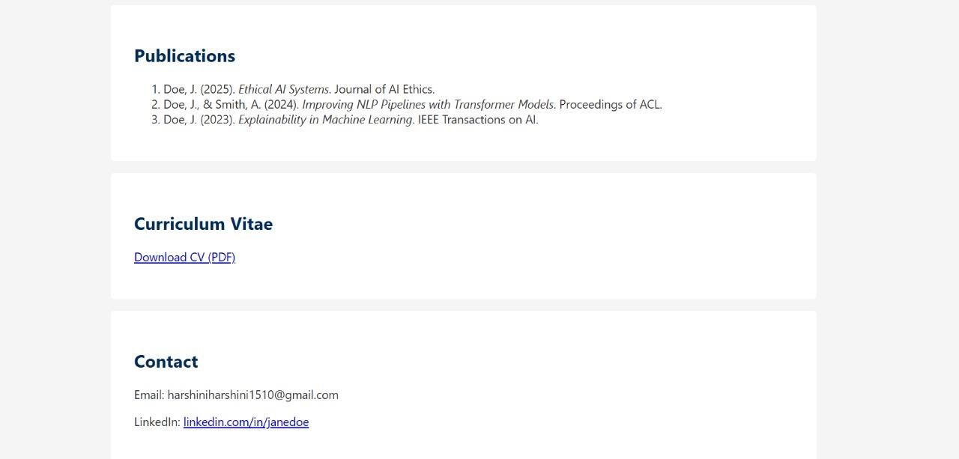

Slide 12
CONCLUSION
The Research Scholar Portfolio project serves as a comprehensive digital platform designed to document, organize, and showcase the academic journey and scholarly contributions of research scholars. By integrating structured sections such as research publications, projects, academic achievements, and skills, the portfolio not only enhances the visibility of a scholar's work but also facilitates collaboration, evaluation, and career development.
Through the use of modern web technologies like HTML, CSS, and JavaScript, the portfolio ensures an interactive and user-friendly experience, while maintaining academic professionalism. Features such as smooth navigation, dynamic content display, and responsive design contribute to a polished presentation of a scholar's profile.
Overall, this project bridges the gap between traditional academic resumes and dynamic
digital identities, empowering research scholars to present their work in a meaningful and impactful way in the digital era.
12

